Slide 1
Doubly Linked List

Slide 2
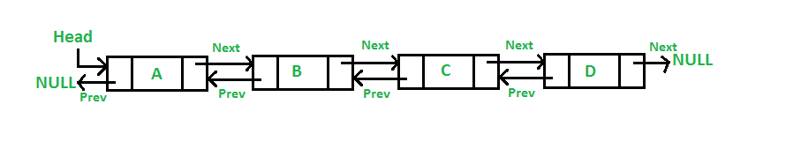
Doubly Linked List (DLL)
A Doubly Linked List (DLL) contains an extra pointer, typically called previous pointer, together with next pointer and data which are there in singly linked list.

Slide 3
Advantages
1) A DLL can be traversed in both forward and backward direction. 2) The delete operation in DLL is more efficient if pointer to the node to be deleted is given. In singly linked list, to delete a node, pointer to the previous node is needed. To get this previous node, sometimes the list is traversed. In DLL, we can get the previous node using previous pointer.

Slide 4
Disadvantages
1) Every node of DLL Require extra space for an previous pointer. It is possible to implement DLL with single pointer though . 2) All operations require an extra pointer previous to be maintained. For example, in insertion, we need to modify previous pointers together with next pointers. For example in following functions for insertions at different positions, we need 1 or 2 extra steps to set previous pointer.
Notes:
Source: https://www.geeksforgeeks.org/doubly-linked-list/

Slide 5
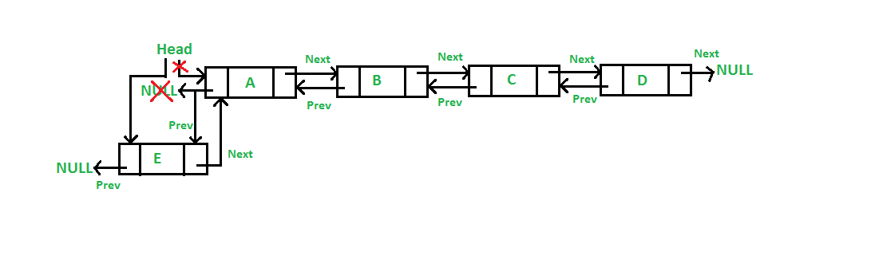
Insertion
1) Add a node at the front: (A 5 steps process)
The new node is always added before the head of the given Linked List. And newly added node becomes the new head of DLL.

Slide 6
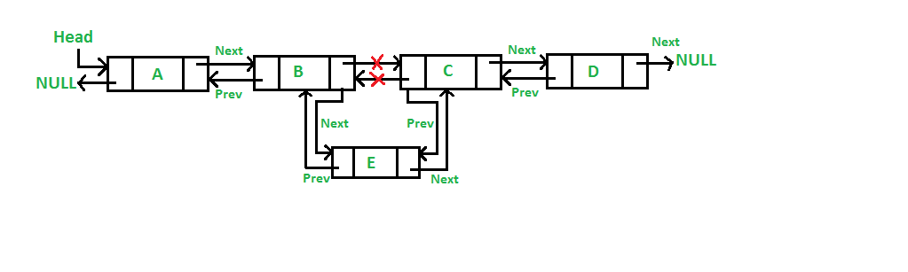
Insertion
2) Add a node after a given node.: (A 7 steps process) We are given pointer to a node as prev_node, and the new node is inserted after the given node.

Slide 7
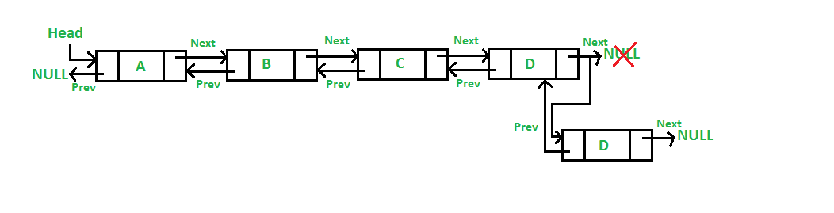
Insertion
3) Add a node at the end: (7 steps process) The new node is always added after the last node of the given Linked List.

Slide 8
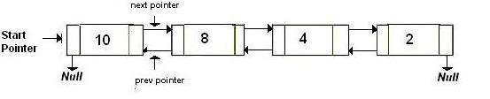
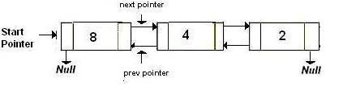
Deletion
(a) After deletion of head node

Slide 9
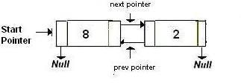
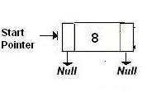
Deletion
(b) After deletion of middle node
(c) After deletion of last node

Slide 10
Algorithm Let the node to be deleted is del. 1) If node to be deleted is head node, then change the head pointer to next current head. 2) Set next of previous to del, if previous to del exists. 3) Set prev of next to del, if next to del exixts.

Slide 11
Question
WAP to reverse Doubly Linked List
Hint: swap prev and next pointers for all nodes, change prev of the head (or start) and change the head pointer in the end.
Soln: reverse_doubly.C

Slide 12
Circular Linked List
Notes:
Source: https://www.geeksforgeeks.org/circular-linked-list/

Slide 13
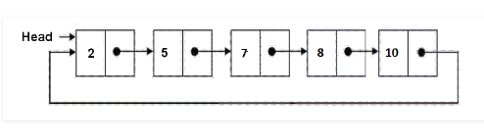
Introduction
Circular linked list is a linked list where all nodes are connected to form a circle. There is no NULL at the end. A circular linked list can be a singly circular linked list or doubly circular linked list.

Slide 14
Advantages of Circular Linked Lists
1) Any node can be a starting point. We can traverse the whole list by starting from any point. We just need to stop when the first visited node is visited again.
2) Useful for implementation of queue. Unlike this implementation, we don’t need to maintain two pointers for front and rear if we use circular linked list. We can maintain a pointer to the last inserted node and front can always be obtained as next of last.
3) Circular lists are useful in applications to repeatedly go around the list. For example, when multiple applications are running on a PC, it is common for the operating system to put the running applications on a list and then to cycle through them, giving each of them a slice of time to execute, and then making them wait while the CPU is given to another application. It is convenient for the operating system to use a circular list so that when it reaches the end of the list it can cycle around to the front of the list. (Source http://web.eecs.utk.edu/~bvz/cs140/notes/Dllists/)
4) Circular Doubly Linked Lists are used for implementation of advanced data structures like Fibonacci Heap.

Slide 15
Traversal
In a conventional linked list, we traverse the list from the head node and stop the traversal when we reach NULL. In a circular linked list, we stop traversal when we reach the first node again.
/* Function to traverse a given Circular linked list and print nodes */
void printList(struct Node *first)
{ struct Node *temp = first;
// If linked list is not empty
if (first != NULL)
{
// Keep printing nodes till we reach the first node again
do
{
printf("%d ", temp->data);
temp = temp->next;
}
while (temp != first);
}}

Slide 16
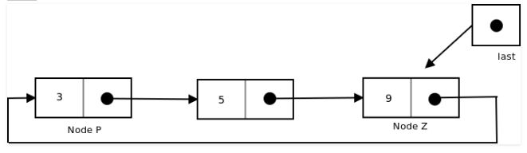
Insertion
To implement a circular singly linked list, we take an external pointer that points to the last node of the list. If we have a pointer last pointing to the last node, then last -> next will point to the first node.

Slide 17
Why have we taken a pointer that points to the last node instead of first node ? For insertion of node in the beginning we need traverse the whole list. Also, for insertion and the end, the whole list has to be traversed. If instead of start pointer we take a pointer to the last node then in both the cases there won’t be any need to traverse the whole list. So insertion in the begging or at the end takes constant time irrespective of the length of the list.

Slide 18
Insertion
Insertion in an empty list
Insertion at the beginning of the list
Insertion at the end of the list
Insertion in between the nodes

Slide 19
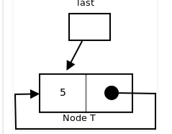
Insertion in an empty List
Initially when the list is empty, last pointer will be NULL.
After inserting a node T, T is the last node so pointer last points to node T. And Node T is first and last node, so T is pointing to itself.
struct Node *addToEmpty(struct Node *last, int data)
{ // This function is only for empty list
if (last != NULL)
return last;
// Creating a node dynamically.
struct Node *last =
(struct Node*)malloc(sizeof(struct Node));
// Assigning the data.
last -> data = data;
// Note : list was empty. We link single node
// to itself.
last -> next = last;
return last;
}

Slide 20
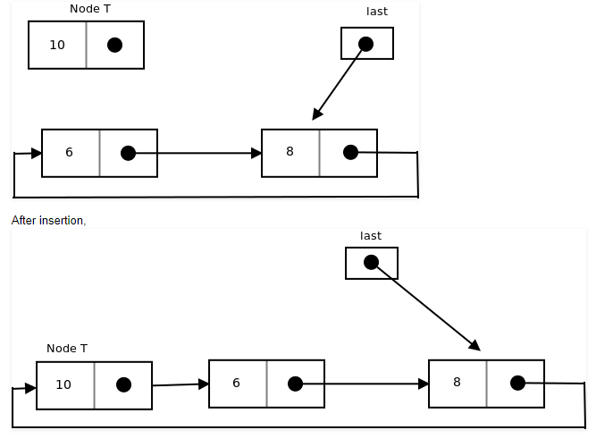
Insertion at the beginning of the list
To Insert a node at the beginning of the list, follow these step: 1. Create a node, say T. 2. Make T -> next = last -> next. 3. last -> next = T.

Slide 21
struct Node *addBegin(struct Node *last, int data)
{
if (last == NULL)
return addToEmpty(last, data);
// Creating a node dynamically.
struct Node *temp
= (struct Node *)malloc(sizeof(struct Node));
// Assigning the data.
temp -> data = data;
// Adjusting the links.
temp -> next = last -> next;
last -> next = temp;
return last;
}

Slide 22
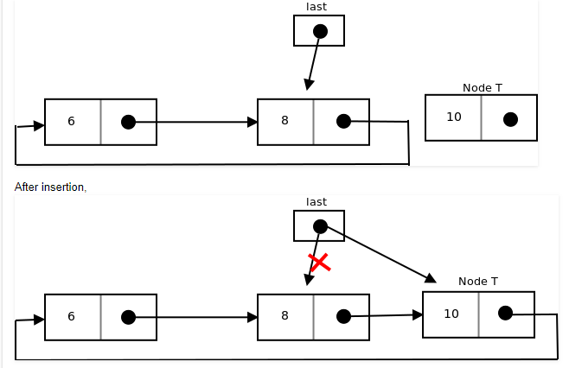
Insertion at the end of the list
To Insert a node at the end of the list, follow these step: 1. Create a node, say T. 2. Make T -> next = last -> next; 3. last -> next = T. 4. last = T.

Slide 23
struct Node *addEnd(struct Node *last, int data)
{
if (last == NULL)
return addToEmpty(last, data);
// Creating a node dynamically.
struct Node *temp =
(struct Node *)malloc(sizeof(struct Node));
// Assigning the data.
temp -> data = data;
// Adjusting the links.
temp -> next = last -> next;
last -> next = temp;
last = temp;
return last;
}

Slide 24
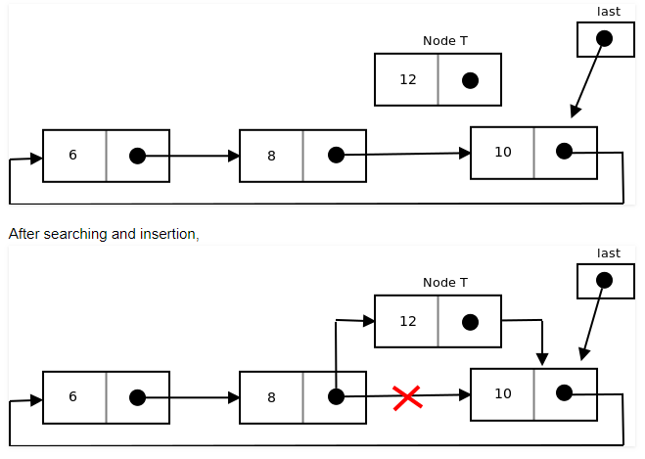
Insertion in between the node
To Insert a node at the end of the list, follow these step: 1. Create a node, say T. 2. Search the node after which T need to be insert, say that node be P. 3. Make T -> next = P -> next; 4. P -> next = T.

Slide 25
struct Node *addAfter(struct Node *last, int data, int item)
{ if (last == NULL)
return NULL;
struct Node *temp, *p;
p = last -> next;
// Searching the item.
do
{ if (p ->data == item)
{
// Creating a node dynamically.
temp = (struct Node *)malloc(sizeof(struct Node));
// Assigning the data.
temp -> data = data;
// Adjusting the links.
temp -> next = p -> next;
// Adding newly allocated node after p.
p -> next = temp;
// Checking for the last node.
if (p == last)
last = temp;
return last;
}
p = p -> next;
} while (p != last -> next);
cout << item << " not present in the list." << endl;
return last;
}

Slide 26
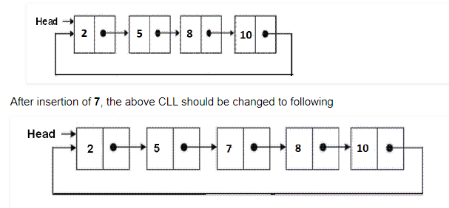
Exercise
Split a Circular Linked List into two halves
Write a C function to insert a new value in a sorted Circular Linked List (CLL). For example, if the input CLL is following.

